Slide 1

Sentiment Analysis On Movie Reviews
N Bhanuteja | P N Shyamala | G Pujitha | G Manaswini

Slide 2
Project Overview
Introduction
Process
Steps
Applications
Conclusion

Slide 3
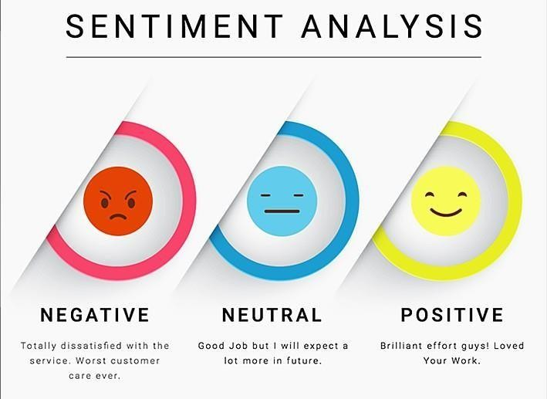
Introduction
Welcome to our Movie Review Sentiment Analysis project. Our objective is to analyze sentiments expressed regarding
about movie reviews. understanding public
In today's digital landscape,
informed
sentiment
is crucial for
decision-making. Through machine learning and natural language processing, we aim to distill meaningful insights from Twitter data. Join us as we explore the nuances of sentiment analysis and its implications for various industries.

Slide 4
Process
Movie Review Sentiment Analysis. It refers to the process of analyzing sentiments or opinions expressed about reviews on the social media platform. This analysis involves using various techniques from natural language processing (NLP) and machine learning to categorize reviews as positive, negative, or neutral based on the sentiment conveyed in the text.
Dataset Loading
Data Preprocessing
Splitting Dataset (Training and Testing)
Model Building
Model Evaluation

Slide 5
1. Dataset Loading
Dataset loading is a first and crucial step in movie review sentiment analysis. It involves finding a suitable dataset on platforms like Kaggle, in this case, dataset about movie reviews, and loading the dataset into Colab.
The process of dataset loading involves several steps and can be done in two ways:
1. Importing from Kaggle using Kaggle API:
Install the Kaggle API package in your Colab notebook.
Generate an API key from your Kaggle account settings.
Upload the API key to your Colab notebook.

Slide 6
Use the Kaggle API to search for and download the desired dataset directly to your Colab environment.
Unzip the downloaded dataset files if necessary.
Read the dataset into your Colab notebook using appropriate libraries like Pandas.
2. Importing from Google Drive: Upload the dataset to your Google Drive.
Mount your Google Drive in Google Colab.
Access the dataset file path in your Google Drive using code.
Read the dataset into your Colab notebook using appropriate libraries like Pandas.
We are using the second method i.e, importing from google drive.

Slide 7
2.Data Preprocessing
Data preprocessing refers to the set of techniques and operations applied to raw data to prepare it for further analysis or modeling. It involves cleaning, transforming, and organizing data into a format suitable for specific tasks.
Data preprocessing involves cleaning, transforming, and organizing raw data to make it suitable for analysis or modeling tasks.
This process involves in several steps, they are
Tokenization: Tokenization is the process of breaking down a text or a sequence of characters into smaller units called tokens. These tokens can be individual words, numbers, punctuation marks, or any other meaningful elements.

Slide 8
Lower Casing: Lowercasing refers to the process of converting all letters in a piece of text to lowercase. Lowercasing is commonly applied in text preprocessing to enhance consistency and simplify analysis
Removing special Characters and Links: Remove special characters and links as part of the cleaning process. Special characters, such as punctuation marks and symbols, typically do not carry significant meaning for many NLP tasks and can introduce noise into the data. Similarly, links or URLs may not be relevant to the analysis and can be removed to focus on the textual content.

Slide 9
Removing Stopwords: Removing stop words is common preprocessing step in natural language processing tasks, aimed at eliminating common words that do not carry significant semantic meaning. Stop words are words like "the", "and", "is", "in", etc., which occur frequently in language but typically do not add much value to the analysis.
Stemming/Lemmatization: Stemming and lemmatization are both techniques used in natural language processing (NLP) to reduce words to their base or root form, which helps in text normalization and improves the efficiency of text analysis tasks such as sentiment analysis, text classification, and information retrieval.

Slide 10
3.Splitting Dataset
Splitting a dataset into training and testing sets is a fundamental step in machine learning model development. This process involves dividing the dataset into two separate subsets: one for training the model and the other for evaluating its performance.
The process involves in the steps:
Separating and labeling: Separating the data and corresponding sentiment in 2 different variables X & Y
label includes storing reviews and
Splitting into Training and Testing: Splitting a dataset into training and testing subsets is a critical step in machine learning to evaluate model performance on unseen data.

Slide 11
4.Model Building
Model building is the process of selecting an efficient model and training and testing using it.
The process involves in the steps:
Converting into Numerical data
Training the Model: Model training in machine language is the process of feeding an ML
algorithm with data so that it can analyze the patterns and predict the output.
Here the model I selected is logistic regression.
Logistic Regression: Logistic Regression is a type of regression analysis used for predicting the probability of a categorical dependent variable. It's particularlyuseful for binary classification problems, where the outcome can take only two possible values, such as "0" or "1", "True" or "False", "Yes" or "No"

Slide 12
5.Model Evaluation
Model evaluation is the process of assessing the performance of a machine learning model to
understand how well it generalizes to unseendata.
Model evaluation aims to define how well the model performs its task.
Checking Accuracy
We evaluate the model by checking the accuracy score of the model built.
Saving The Model
Saving the model that has been trained and tested in a file.

Slide 13
Applications
Here are some specific applications of Movie Review Sentiment Analysis:
Movie Recommendation Systems
Audience Engagement Analysis
Box Office Performance Prediction
Content Curation for Streaming platforms
Market Research for Filmmakers
Review Aggregation Websites
Content Quality Assessment

Slide 14
Conclusion
Our Movie Review Sentiment Analysis project achieved high accuracy scores: 92.01% for training data and 88.20% for testing data. These scores show that our machine learning model effectively understood the feelings expressed in reviews about the movie. By carefully preparing the data and training the model, we learned a lot about what people think. This information can help us make smart choices regarding filmmaking in different aspects.
While our model did well, there's still room to make it even better. In the future, we can try new methods to improve accuracy. Overall, our project shows how valuable Movie Review Sentiment Analysis can be. It helps us deeper understanding of audience preferences and behaviors in the ever-evolving landscape of film and entertainment.

Slide 15
THANK YOU

